Slide 1

HS301
Role of Hedge Funds in Financial Markets
Hedge funds emerged in the 1940s, initially as a way for wealthy individuals to hedge their portfolios against market downturns. Over time, they evolved into sophisticated investment vehicles with diverse strategies.

Slide 2

Introduction to Hedge Funds
Pooled Investment
Flexibility
Hedge funds are pooled investments managed by a partnership of institutional or accredited investors.
Hedge funds have fewer restrictions than traditional investment methods, allowing managers to pursue a broader range of strategies.
Private Partnerships
They are structured as private investment partnerships and require substantial minimum investments, catering to wealthy individuals or institutions.

Slide 3

Key Differences
Feature
Hedge Funds
Mutual Funds
Strategies
More complex and aggressive
Typically long-only equity or bond investments
Regulation
Lighter regulatory scrutiny
Subject to stricter regulations
Fees
Higher fees (2 and 20 model)
Lower fees
Liquidity
Limited liquidity
Daily liquidity

Slide 4
Types of Hedge Funds
1
Long/Short Equity
2
Market Neutral
3
Event-Driven
Involves buying undervalued stocks (long positions) and shorting overvalued stocks (short positions).
Aims to eliminate market risk by taking long and short positions in correlated securities.
Focuses on investing in companies undergoing significant corporate events like mergers, acquisitions, or restructurings.
4
Global Macro
5
Quantitative
Makes investment decisions based on macroeconomic trends and geopolitical events.
Employs mathematical models and statistical techniques to identify trading opportunities.

Slide 5
Common Investment Strategies
Long/Short Equity
Market Neutral
Investors simultaneously buy undervalued stocks (long positions) and sell short overvalued stocks (short positions).
Involves taking long and short positions in securities with similar economic characteristics but different price trends.
Objective: To profit from both rising and falling markets.
Objective: To minimize market risk by offsetting gains and losses from long and short positions.

Slide 6
Common Investment Strategies (Continued)
Event-Driven
Global Macro
Quantitative
Focuses on investing in companies undergoing significant corporate events such as mergers, acquisitions, spin-offs, or restructurings.
Makes investment decisions based on broad economic trends and geopolitical events.
Employs sophisticated mathematical models and statistical techniques to identify trading opportunities.
Objective: To identify and exploit macroeconomic opportunities, such as interest rate changes, currency fluctuations, and commodity price movements.
Objective: To generate consistent returns through systematic, data-driven approaches.
Objective: To capitalize on price discrepancies and market inefficiencies that arise during these events.

Slide 7




Leverage and Risk Management in Hedge Funds
Leverage
Leverage refers to the use of borrowed money to amplify potential returns.
Benefits
Leverage allows hedge funds to generate higher returns by
magnifying their market exposure. This can enhance its
ability to achieve market neutrality and generate alpha.
Risks
Leverage also amplifies losses, increasing the likelihood of
margin calls and the potential for systemic risk.

Slide 8
Risk Management Techniques
1
Diversification
2
Stress Testing
Spreading investments across different asset classes and strategies reduces the impact of any single adverse event.
Simulating different market scenarios to assess portfolio vulnerability and identify potential risks.
3
Position Sizing
4
Liquidity Management
Carefully managing the size of each position relative to the overall portfolio capital.
Maintaining sufficient cash and easily saleable assets to meet margin calls and unforeseen needs.
5
Hedging Strategies
6
Value at Risk (VaR)
Using derivative instruments to offset exposure to specific risks.
A statistical metric that estimates the potential loss of a portfolio over a given time period with a certain level of confidence.

Slide 9
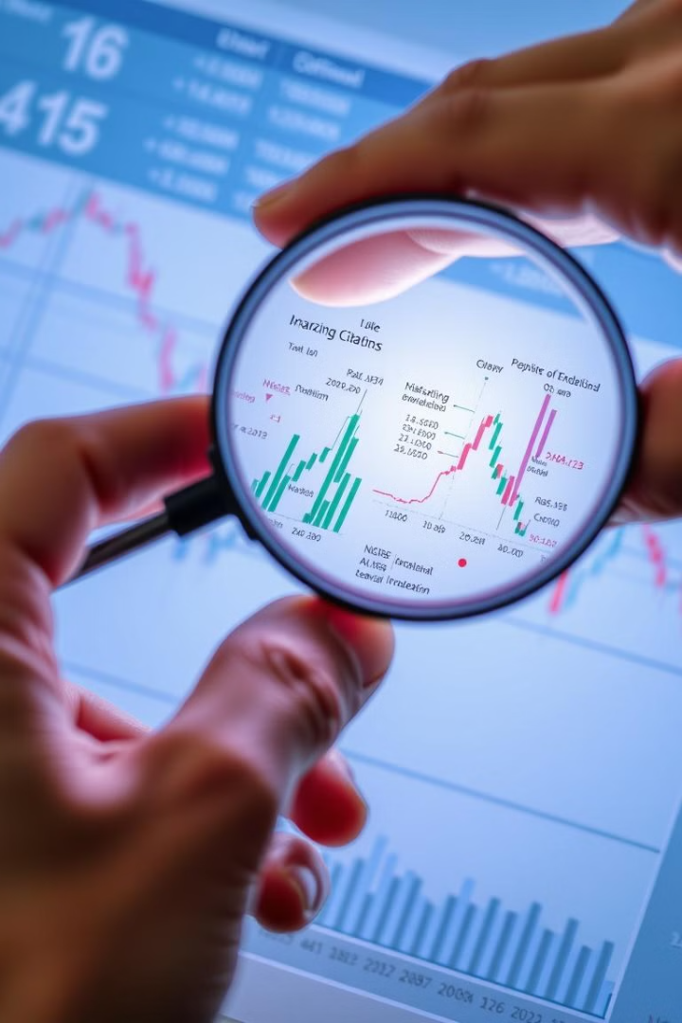
Influence on
Financial Markets
Hedge funds play a significant role in financial markets. They invest in various assets, including stocks, bonds, and derivatives. Their strategies range from long-term investments to high-frequency trading.

Slide 10



Hedge Funds and Price Discovery
Market Information
Market Efficiency
Market Volatility
Hedge funds actively gather and analyze market information to identify potential opportunities. They use this information to make informed trading decisions, affecting the price of assets.
Their participation improves market efficiency by reflecting accurate information into asset prices. They identify mispricing's and exploit them, contributing to more efficient price discovery.
Their strategies, such as short-selling and arbitrage, can increase market volatility, as they actively seek to profit from price fluctuations.

Slide 11
Hedge Funds and Market Crises
Role in 2008
Impact on Market
Regulation and Oversight
Hedge funds played a significant role in the 2008 financial crisis. They invested heavily in mortgage-backed securities and other complex financial instruments. When the housing bubble burst, many hedge funds suffered significant losses.
Their losses exacerbated the crisis, leading to a decline in market liquidity and a sharp drop in asset prices. Hedge funds also contributed to the crisis by engaging in excessive leverage and risky investments.
The crisis highlighted the need for greater regulation and oversight of hedge funds. The Dodd-Frank Wall Street Reform and Consumer Protection Act of 2010 introduced new regulations to increase transparency and reduce systemic risk.

Slide 12
Hedge Funds and Market Volatility
1
High-Frequency Trading
Hedge funds engage in high-frequency trading (HFT) to exploit small price differences in a fraction of a second, leading to increased market volatility and potential instability.
2
Short-Selling
Hedge funds often short-sell assets, betting on their price decline. This can contribute to increased market volatility, especially during periods of uncertainty or market downturns.
3
Market Sentiment
The actions of hedge funds, particularly their large trades, can impact market sentiment and lead to herd behavior, potentially amplifying price fluctuations.

Slide 13

Hedge Fund Performance Metrics
Evaluating hedge fund performance goes beyond simply looking at returns. Investors need to consider a range of factors to make informed investment decisions.

Slide 14

Importance of
Performance Metrics
1
Transparency
2
Comparison
Metrics provide transparency into the fund's strategies and risk management practices, allowing investors to make informed decisions.
Investors can compare the performance of different hedge funds using consistent metrics, allowing for a more objective assessment.
3
Assessment
4
Decision Making
Metrics provide a quantitative basis for assessing the fund's performance against its stated objectives and market conditions.
Metrics help investors make better investment decisions by providing insights into the fund's risk-adjusted returns, fees, and overall performance.

Slide 15
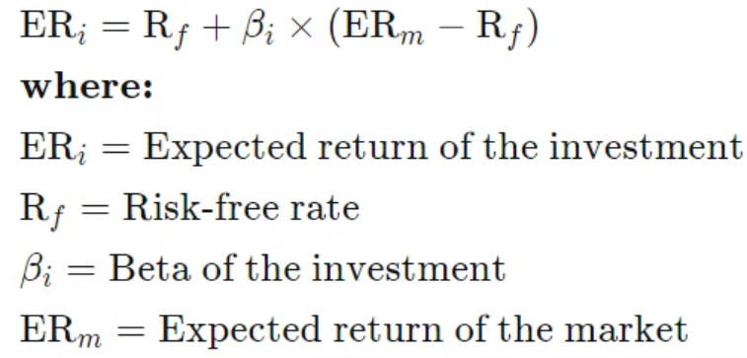
Key Aspects of Evaluating Hedge Fund Performance
Alpha
Measures the excess return of an investment relative to a benchmark index, considering the risk of the investment.
Calculated using the Capital Asset Pricing Model (CAPM).
Positive alpha indicates outperformance, while negative alpha indicates underperformance.
Beta
Measures a stock's volatility or the degree to which its price fluctuates relative to the market as a whole.
A benchmark index is used to represent the market in beta calculation.
The formula is: Covariance (Ri, Rm) / Variance (Rm)

Slide 16
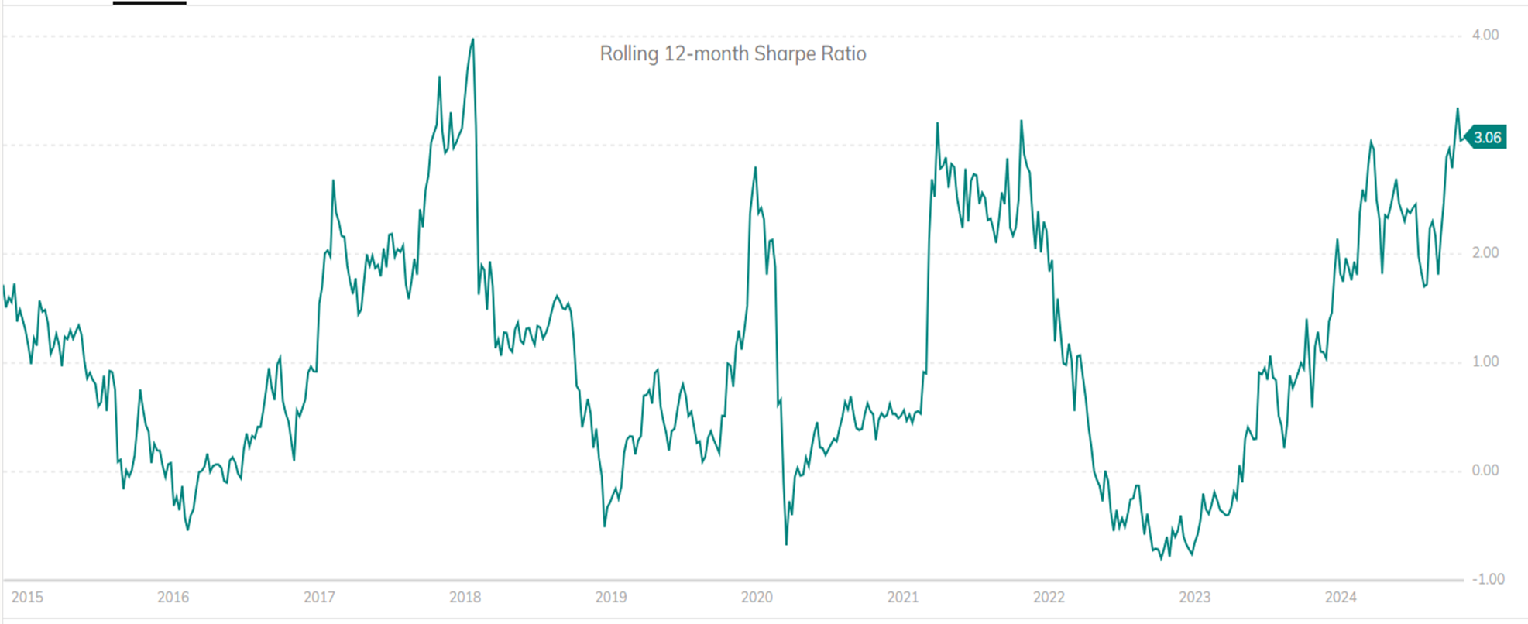
Key Aspects of Evaluating Hedge Fund Performance (Continued)
Sharpe Ratio
Measures the performance of an asset or group of assets relative to their assumed risk.
Formula: (Return of Asset – Risk-Free Return) / Standard Deviation of Asset's Rate of Return
S&P 500 Portfolio Sharpe Ratio

Slide 17
Additional Risk Measures: Drawdown & Information Ratio
Maximum Drawdown
Information Ratio
Represents the largest peak-to-trough decline in the fund's value during a specific period.
Calculated as the excess return of the fund divided by the tracking error (volatility of the excess return).

Slide 18

Challenges in Assessing Hedge Fund Performance
1
Lack of Standardized Reporting
2
Survivorship Bias
Differences in reporting practices can make it challenging to compare performance across various funds.
Performance data may be skewed due to the exclusion of funds that have failed, leading to an overestimation of average performance.
3
Strategy and Market Conditions
It's crucial to consider the fund's investment strategy and the prevailing market conditions when assessing its performance.

Slide 19
Controversies Surrounding Hedge Funds
Hedge funds, known for their complex investment strategies and high-risk, high-return approach, have long been the subject of intense scrutiny and debate. Their opaque operations and potential impact on markets have raised significant concerns among regulators, investors, and the public.
Transparency Issues
1
Lack of Disclosure
Unregulated Reporting
Conflicts of Interest
Complex Structures
Hedge funds often operate with limited transparency, making it difficult for investors to fully understand their investment strategies, risk profiles, and performance.
The lack of standardized reporting requirements for hedge funds can make it challenging to compare their performance and holdings.
Hedge fund managers may have incentives that conflict with the best interests of their investors, leading to concerns about fair treatment.
Hedge funds may use complex financial instruments and offshore vehicles, further obscuring their activities from public view.

Slide 20
Controversies Surrounding Hedge Funds (Continued)
Market Manipulation Allegations
2
Short-Selling Practices
Insider Trading Concerns
Activist Strategies
Hedge funds have been accused of engaging in short-selling tactics that can artificially depress the prices of certain stocks, potentially harming investors and companies.
There have been allegations that some hedge funds have used insider information or undisclosed research to gain unfair trading advantages.
Activist hedge funds that take large positions in companies and aggressively push for changes have been criticized for disrupting market stability and corporate governance.

Slide 21
Hedge Fund Case Studies
Bridgewater Associates
1
Five Forces Framework
Strategic Positioning
Risk Parity Model
Bridgewater leverages Porter's framework to understand industry dynamics and gain a competitive advantage.
Bridgewater's risk management and strategic decision-making during the 2008 financial crisis solidified its position in the investment sector.
Bridgewater's implementation of the risk parity model has contributed to its ability to generate consistent risk-adjusted returns for clients.

Slide 22

Hedge Fund Case Studies (Continued)
Melvin Capital
2
GameStop Saga
Investor Response
Fund Closure
Melvin Capital suffered significant losses due to wrong-way bets on GameStop.
Retail investors coordinated online to drive up GameStop's stock price, impacting Melvin's short positions.
Melvin Capital ultimately shut down after experiencing substantial losses and a bailout from other hedge funds.

Slide 23
Trends Shaping the Future Hedge Funds
1
Benefits
AI in Hedge Funds
Improved Decision-Making
Increased efficiency
Risk Management
Optimized Trading Strategies
Cost Reduction
Hedge funds are entering a new era poised to reshape investment strategies and operational efficiencies with the advent of generative artificial intelligence (gen AI), according to research from the Alternative Investment Management Association (AIMA).
High adoption rate: 86% of hedge fund managers surveyed now grant their staff access to various Gen AI tools to bolster their work, representing a widespread embrace of this transformative technology
Challenges
Inaccurate Predictions
Lack of Transparency
Reputational Concerns
Security Risks
Balancing the Use of Technology

Slide 24
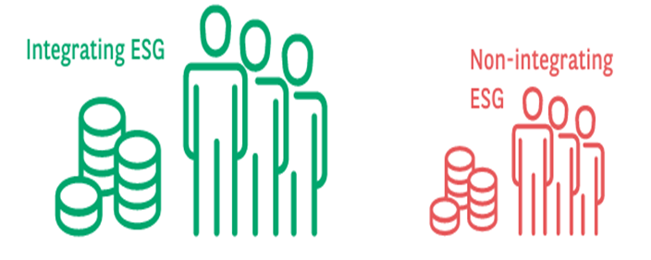
Trends Shaping the Future Hedge Funds (Continued)
2
ESG (Environmental, Social, & Governance)
Companies and funds currently integrating ESG (Environmental, Social, and Governance) criteria tend to be larger in terms of both Assets Under Management (AUM) and the number of employees than those that are not.
BNP Paribas (a French multinational banking and financial services company) published the following data: It conducted an online survey of 53 hedge funds and some deeper qualitative interviews.
40% of participants integrate ESG into their investment process
60% of the participants do not integrate ESG
55% of respondents believe we saw increased demand for ESG-integrated investments post-COVID

Slide 25
Conclusion
Key Takeaways
Market Impact
Hedge funds employ diverse investment strategies to generate returns, often using complex financial instruments.
Hedge funds can influence market dynamics through their trading activities, contributing to volatility and liquidity.
Regulatory Oversight
Investor Considerations
Policymakers closely monitor hedge funds to mitigate systemic risks and ensure market stability.
Hedge fund investments carry higher risks, but can also offer diversification and potential for higher returns.

